Slide 1
Place of our stay

Slide 2
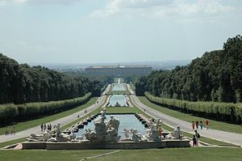
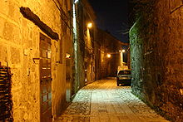
CASERTA
HISTORY
The city and vicinity were the property of the Acquaviva family, who, being pressed by huge debts, sold all the land to the royal family. The royal family then selected Caserta for the construction of their new palace, which, being in land was seen as more defensible than the previous palace fronting the Bay of Naples
The original population moved from Casertavecchia to the current site in the 16th century
CASERTA
Is located in Southern part of Italy (40 km north from Naples), is part of the Italian metropolis.
Population: about 79.488
Area: 53 km²
PALACE CASERTA
PALACE CASERTA
Former royal kings residence in southern Italy
Was built for the Burbon royal family from Napoli
CASERTAVECCHIA
CASERTAVECCHIA
Medieval Village
Casertavecchia is translated as „Old Caserta“
In the presence of well knows turistic spot
Sights: Church, Bell tower, remains of the original castle

Slide 3
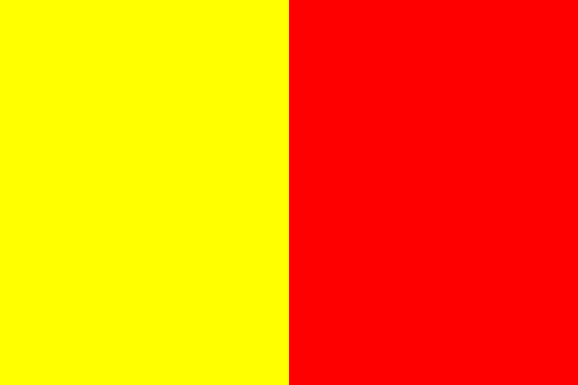
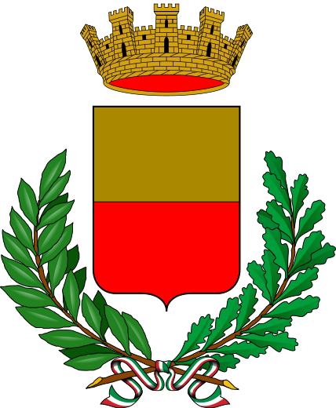
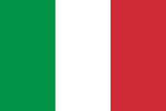
Naples
Naples is the capital city of Campania region and economic center of southern Italy.
The city has over 962 thousand citizens.
Total area of Naples is 117km2
Naples is traditionally credited as the home of pizza - „Margherita“ – named after Queen Margherita.
The most popular sport in the city is football, Italian footbal fans know Marek Hamšík as a good Slovakian player.
Naples' 2,800-year-history has left it with a wealth of historical buildings and monuments, from medieval castles to clasical ruins. - Piazza del Plebiscito, church of San Francesco di Paola and Teatro di San Carlo

Slide 4
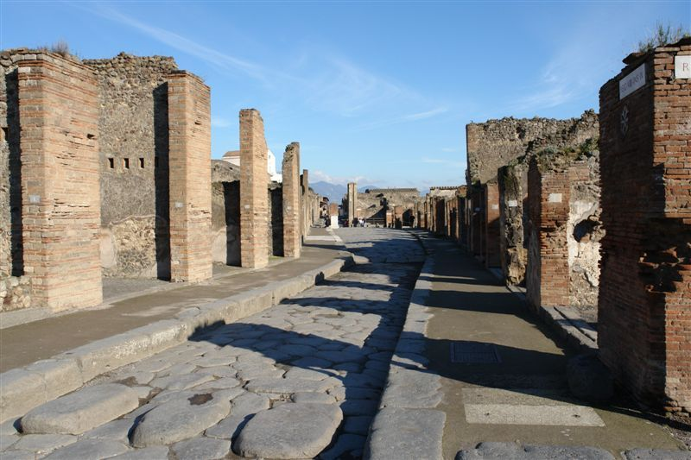
Pompei
Located at the eastern borders of its province (Naples), and its urban area is contiguous with Scafati, in the Province of Salerno. Pompeii is an underground city that was left in ruins after a volcanic eruption occurred.
The first tragedy: 62 AD. An earthquake. Much of the city was transformed into a pile of rubble.
Second tragedy: 24 August 79 AD. Eruption of Vesuvius. The volcano, which was for centuries considered extinct, shortly after noon that day exploded with devastating force. Destruction lasted three days. Pompeii was buried under six-meter layer of fine volcanic ash, rocks and mud mixed with water.

Slide 5
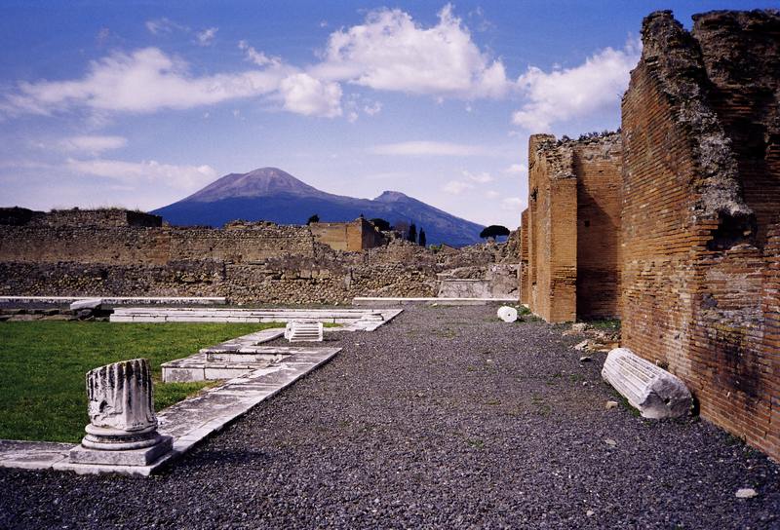
Mount Vesuvius
Mount Vesuvius is a stratovolcano in the Gulf of Naples, Italy, about 9 kilometers (5.6 miles) east of Naples and a short distance from the shore. It is the only volcano on the European mainland to have erupted in the last hundred years, although it is not currently erupting. Vesuvius was a name of the volcano in frequent use by the authors of the late Roman Republic and the early Roman Empire.

Slide 6
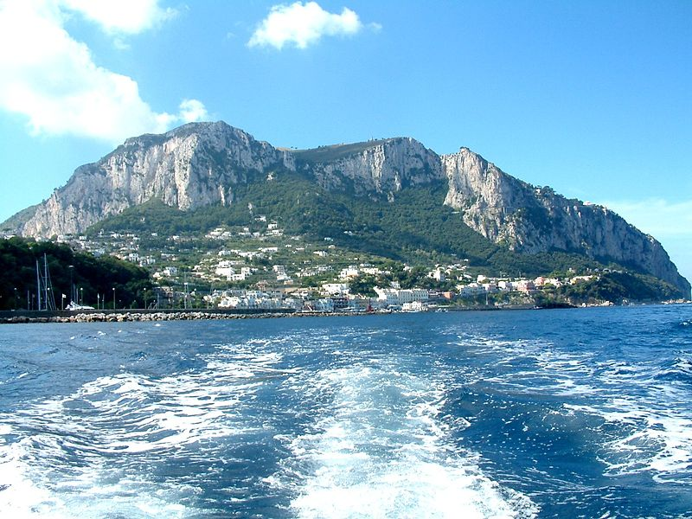
Capri is an Italian island in the Tyrrhenian Sea off the Sorrentin Peninsula, on the south side of the Gulf of Naples, in the Campania region of Southern Italy. It has been a resort since the time of the Roman Republic. Capri is part of the region of Campania, Province of Naples. The town of Capri is the main centre of population on the island. It has two harbours, Marina Piccola and Marina Grande (the main port of the island). The separate comune of Anacapri is located high on the hills to the west.
Capri

Slide 7
Thanks for watching

